Slide 1


Disease modeling with EMOD
Introductory workshop,
ASTMH 2019

Slide 2
Our philosophy
We believe that a basic understanding of disease modeling benefits the entire global health community
Models can provide new insight into old problems or test new solutions
In the field, can enable the collection of more valuable data
In turn enables more powerful/accurate models
Everyone benefits from increased dialog across boundaries of expertise

Slide 3
GOALS!
What you should get out of the workshop:
Basic understanding of compartmental and agent-based models
Training on open-source, readily-available modeling tools
Resources to answer questions and increase your expertise
Neat swag and a free dinner!
What we are getting out of the workshop:
An opportunity to connect with members of the global health community and a chance to pique interest in learning about disease modeling
Potential new users for our software: more use = more refinement or feature additions = better software!

Slide 4


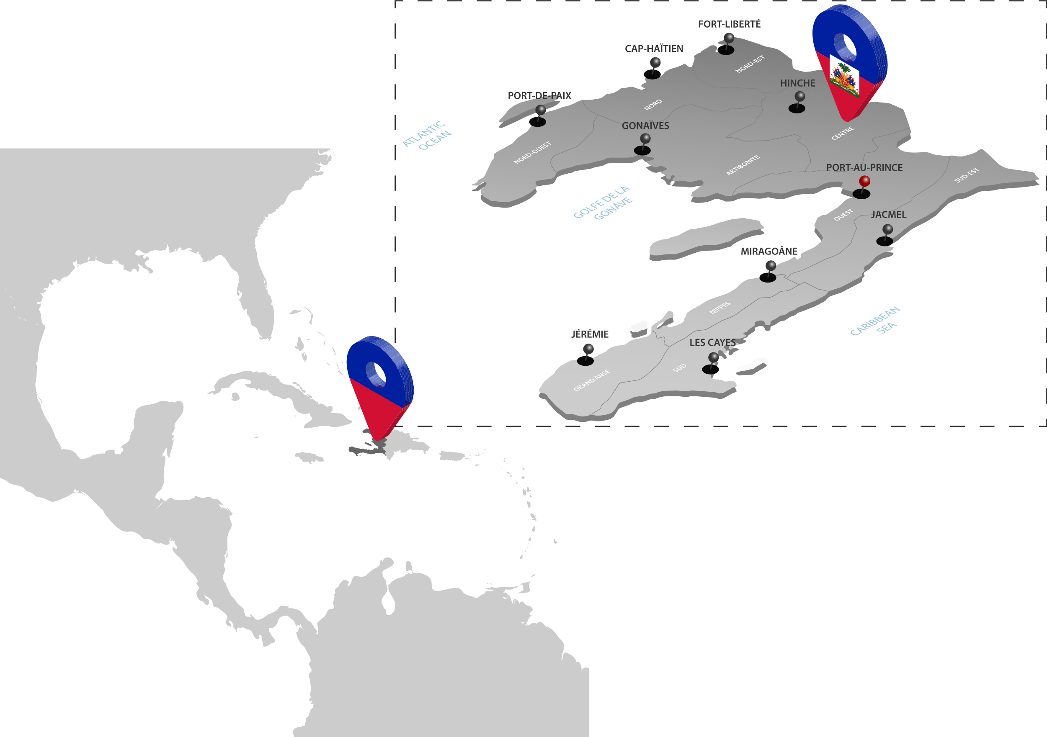
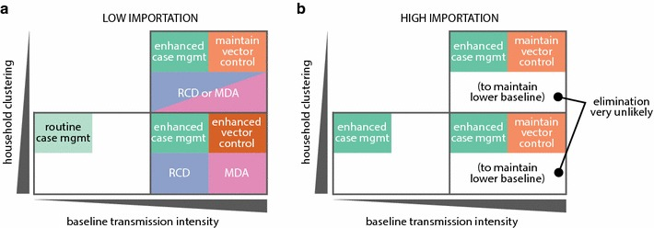
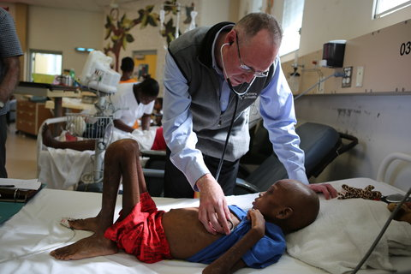

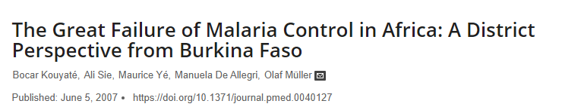


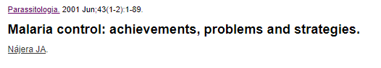
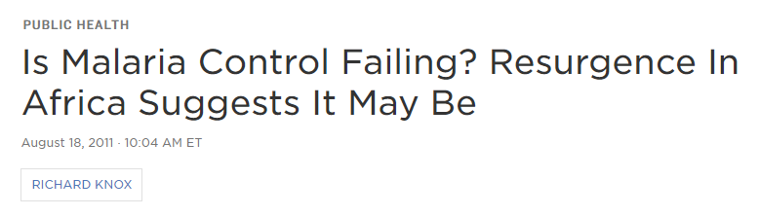

Our motivation
October 2007
IDM shapes global efforts to eradicate infectious disease and to achieve permanent improvements in the health of those most in need.
By developing, using, and freely sharing computational modeling tools, we advise policymakers, promote quantitative decision-making, and advance scientific methodologies.
IDM is an institute within the Global Good Fund, a collaboration between Intellectual Ventures and Bill and Melinda Gates.
Recommended intervention mixes for elimination in a) low- and b) high-importation settings, stratified by local baseline transmission intensity and household clustering. High-clustering, low baseline transmission based on results from Bbondo HFCA; low-clustering, high baseline transmission based on Luumbo HFCA; high-clustering, high baseline transmission based on Munyumbwe HFCA
From: Gerardin et al 2017, Effectiveness of reactive case detection for malaria elimination in three archetypical transmission settings: a modeling study. Malaria Journal. 16:248.
Dr. Paul Farmer examines a 10 year old child with TB and HIV. Photo from the New York Times, courtesy of Rebecca E. Rollins/Partners in Health

Slide 5


About IDM
Malaria
Polio
TB
HIV
Typhoid
Cholera
Epidemics
Vaccine Econ
Family Planning
Applied Math
RESEARCH
Model dev
Testing
UI dev
Visualizations
HPC mgmt
Python tools
SOFTWARE
DEVELOPMENT

Slide 6


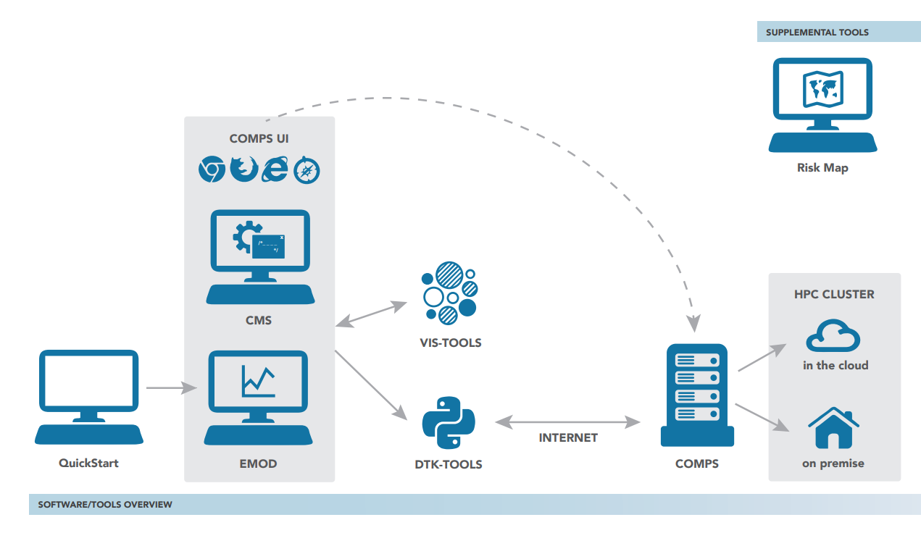
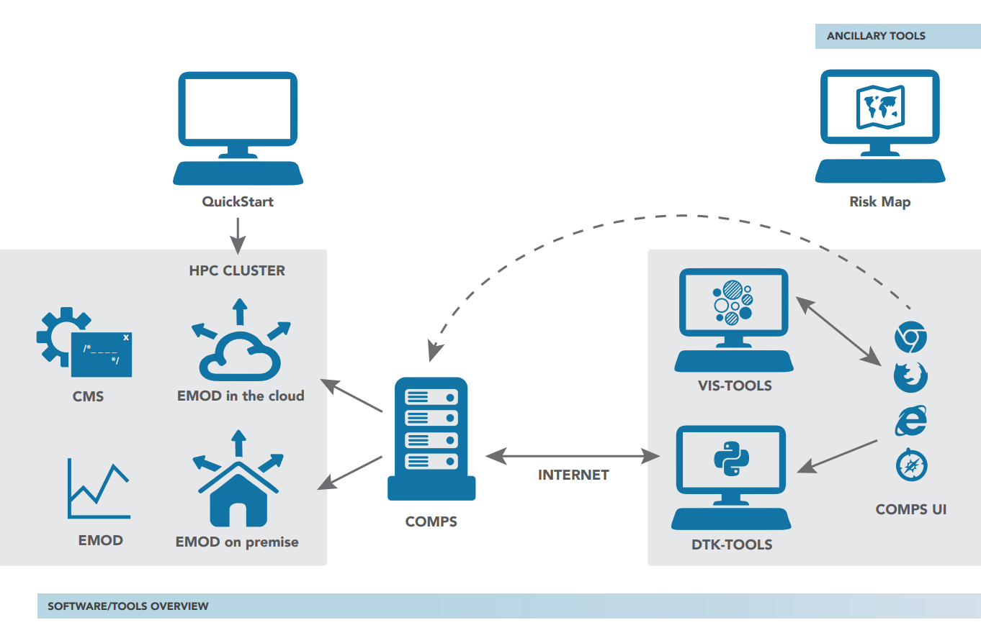



IDM modeling tools
Dis
Dis
Create, calibrate, run, manage simulations
Create shape files
STAMP
IDM-Tools
COMPS
Analyze data
Dis
Visualize data
Model disease
Dis
IDM-Tools
Vis-Tools
EMOD
CMS
Dis
Visualize RSV data
Dis
Dis
Learn the model
Integrate VA data
RSV Trends
Dis
QuickStart
Create risk maps
EasyVA
Risk Map

Slide 7
Overview
(Already done, pre-workshop)
Tech troubleshooting & making sure you can boot from the thumb drive
Part 1: Compartmental models
Background & functionality
SIR model mathematics
Shiny app exercises
Extending SIR models
Shiny app exercises
Part 2: Adding complexity/heterogeneity
Introducing individuals to models
Adding heterogeneity to models
Moving to agent-based models
ABM Shiny app exercises
Introduction to EMOD
EMOD QuickStart exercises
Please join us this evening for an IDM-hosted dinner at Rosa Mexicano, following the conclusion of the advanced session at 6:00 pm!

Slide 8
Part 1: Introduction to disease modeling
Notes:
Introductions, goals, etc.
Will want to make sure no one had installation issues, but we can probably do that prior to starting "Part 2"

Slide 9
About compartmental models
For more information, see:
Keeling, M. J., & Rohani, P. (2011). Modeling infectious diseases in humans and animals. Princeton University Press.
Bjørnstad, Ottar N. (2018) Epidemics: models and data using R.
Anderson, R. M., & May, R. M. (1992). Infectious diseases of humans: dynamics and control. Oxford university press.
Diekmann, O., Heesterbeek, H., & Britton, T. (2012). Mathematical tools for understanding infectious disease dynamics. Princeton University Press.

Slide 10
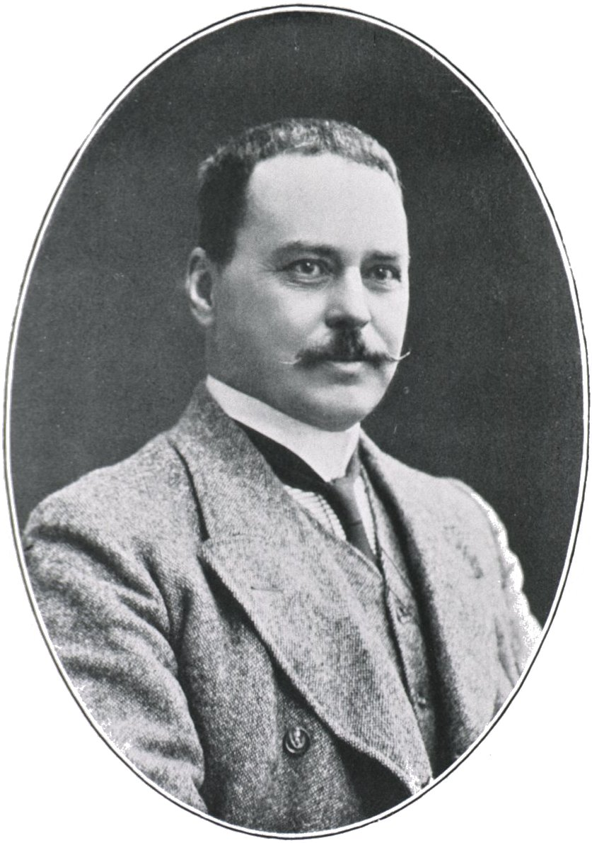
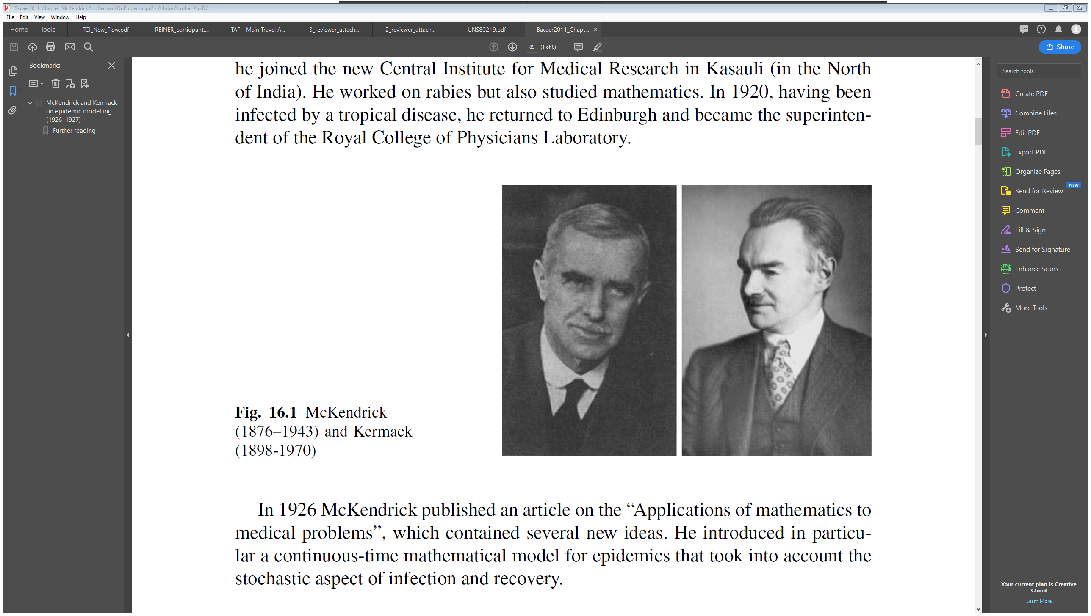
Compartmental models
William Kermack
Anderson McKendrick
Ronald Ross

Slide 11
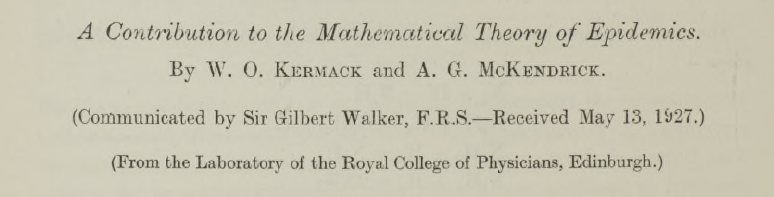
Compartmental models
William Kermack
Anderson McKendrick

Slide 12
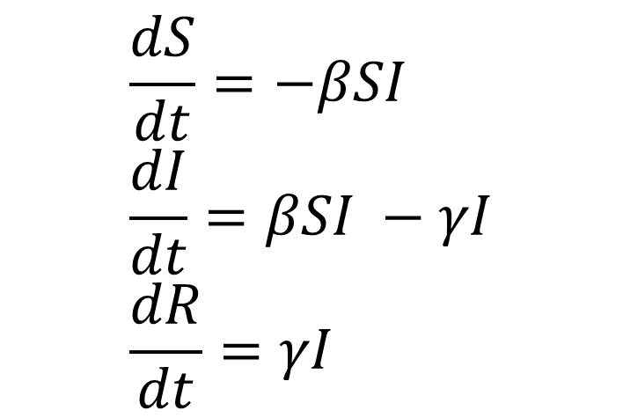
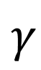
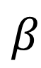
Compartmental models
$$β$$
$$γ$$
Susceptible
Infectious
Recovered
$$\frac{dS}{dt}=−βSI \\ \frac{dI}{dt}=βSI −γI \\ \frac{dR}{dt}=γI$$
William Kermack
Anderson McKendrick

Slide 13
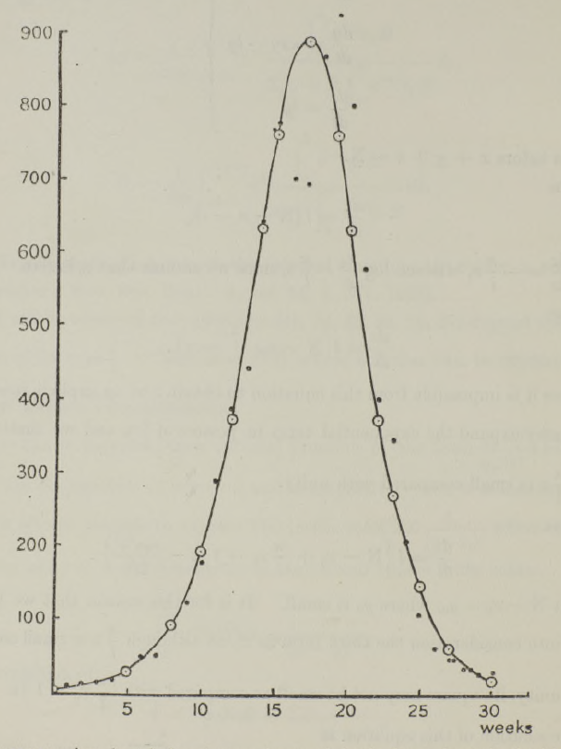
Compartmental models
Weekly plague deaths
1905/1906 Bombay
William Kermack
Anderson McKendrick

Slide 14
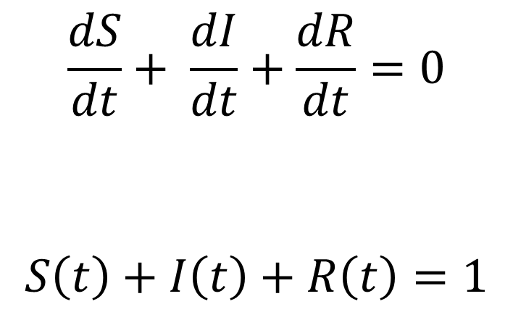
Compartmental models
$$β$$
$$γ$$
Susceptible
Infectious
Recovered
$$\frac{dS}{dt}+ \frac{dI}{dt}+\frac{dR}{dt}=0$$
$$S\left(t\right)+I\left(t\right)+R\left(t\right)=1$$
William Kermack
Anderson McKendrick

Slide 15
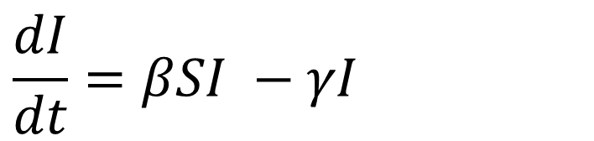
Compartmental models
$$β$$
$$γ$$
Susceptible
Infectious
Recovered
$$\frac{dI}{dt}=βSI −γI$$
William Kermack
Anderson McKendrick

Slide 16
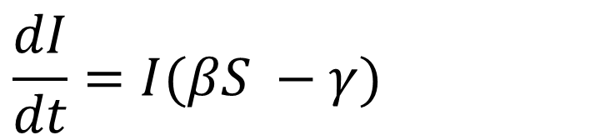
Compartmental models
$$β$$
$$γ$$
Susceptible
Infectious
Recovered
$$\frac{dI}{dt}=I(βS −γ)$$
William Kermack
Anderson McKendrick

Slide 17
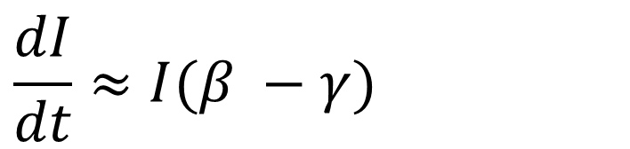
Compartmental models
$$β$$
$$γ$$
Susceptible
Infectious
Recovered
$$\frac{dI}{dt}≈I(β −γ)$$
William Kermack
Anderson McKendrick

Slide 18
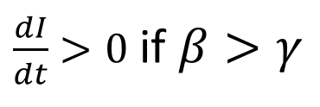
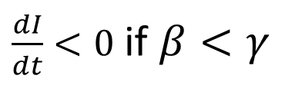

Compartmental models
$$β$$
$$γ$$
Susceptible
Infectious
Recovered
$$\frac{dI}{dt}≈I(β −γ)$$
$$⇒$$
$\frac{dI}{dt}<0$ if $β<γ$
$\frac{dI}{dt}>0$ if $β>γ$
William Kermack
Anderson McKendrick

Slide 19

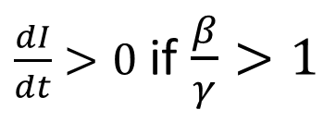
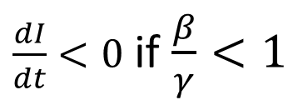
Compartmental models
$$β$$
$$γ$$
Susceptible
Infectious
Recovered
$$\frac{dI}{dt}≈I(β −γ)$$
$$⇒$$
$\frac{dI}{dt}<0$ if $β<γ$
$\frac{dI}{dt}>0$ if $β>γ$
$$⇒$$
$\frac{dI}{dt}<0$ if $\frac{β}{γ}<1$
$\frac{dI}{dt}>0$ if $\frac{β}{γ}>1$
William Kermack
Anderson McKendrick

Slide 20
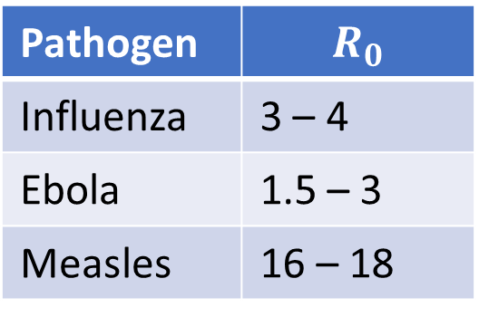
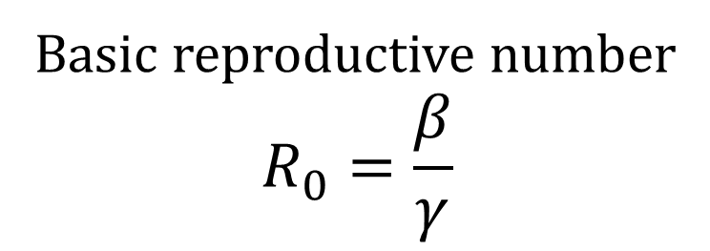
Compartmental models
$$β$$
$$γ$$
Susceptible
Infectious
Recovered
Basic reproductive number
$$R_{0}=\frac{β}{γ}$$
Pathogen | $$R_{0}$$
Influenza | 3 – 4
Ebola | 1.5 – 3
Measles | 16 – 18
William Kermack
Anderson McKendrick

Slide 21
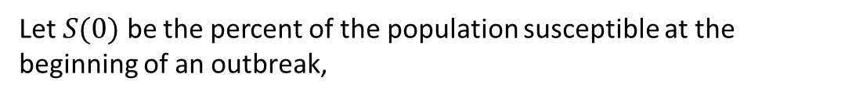
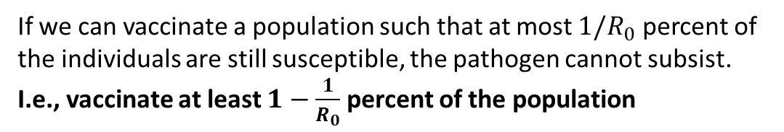
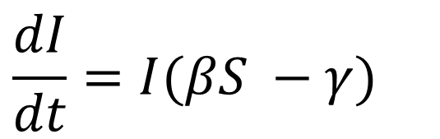
Compartmental models
$$β$$
$$γ$$
Susceptible
Infectious
Recovered
$$\frac{dI}{dt}=I(βS −γ)$$
Let $S(0)$ be the percent of the population susceptible at the beginning of an outbreak,
If $\frac{1}{R_{0}}=\frac{γ}{β}>S\left(0\right)$, then $\frac{dI}{dt}<0$ and the outbreak dies out.
If we can vaccinate a population such that at most $1/R_{0}$ percent of the individuals are still susceptible, the pathogen cannot subsist. I.e., vaccinate at least $1−\frac{1}{R_{0}}$ percent of the population
William Kermack
Anderson McKendrick

Slide 22
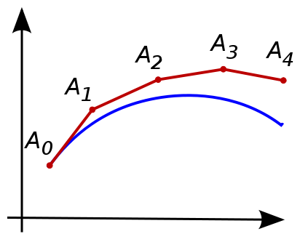
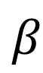
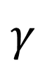
Compartmental models
$$β$$
$$γ$$
Susceptible
Infectious
Recovered
The basic SIR model does not admit a simple analytic solution. It is, however, relatively easy to approximate this solution.
The simplest approximation procedure, the Euler method, approximates the changes in S, I, and R by taking small steps forward in time assuming linear rates of change.

Slide 23
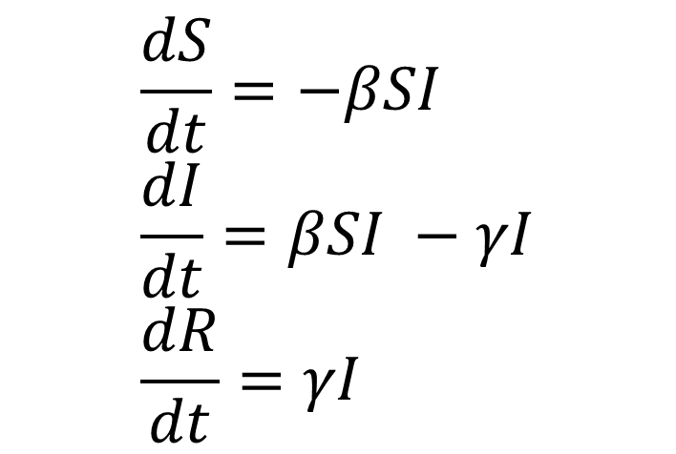
Compartmental models
$$β$$
$$γ$$
Susceptible
Infectious
Recovered
$$\frac{dS}{dt}=−βSI \\ \frac{dI}{dt}=βSI −γI \\ \frac{dR}{dt}=γI$$
$$S\left(t+Δt\right)≈S\left(t\right)−βS\left(t\right)I\left(t\right)∗Δt$$

Slide 24
Compartmental models
$$β$$
$$γ$$
Susceptible
Infectious
Recovered
$$\frac{dS}{dt}=−βSI \\ \frac{dI}{dt}=βSI −γI \\ \frac{dR}{dt}=γI$$
$$S\left(t+Δt\right)≈S\left(t\right)−βS\left(t\right)I\left(t\right)∗Δt$$
$$I\left(t+Δt\right)≈I\left(t\right)+\left(βS\left(t\right)I\left(t\right)−γI\left(t\right)\right)∗Δt$$

Slide 25
Compartmental models
$$β$$
$$γ$$
Susceptible
Infectious
Recovered
$$\frac{dS}{dt}=−βSI \\ \frac{dI}{dt}=βSI −γI \\ \frac{dR}{dt}=γI$$
$$S\left(t+Δt\right)≈S\left(t\right)−βS\left(t\right)I\left(t\right)∗Δt$$
$$I\left(t+Δt\right)≈I\left(t\right)+\left(βS\left(t\right)I\left(t\right)−γI\left(t\right)\right)∗Δt$$
$$R\left(t+Δt\right)≈R\left(t\right)+γI\left(t\right)∗Δt$$

Slide 26
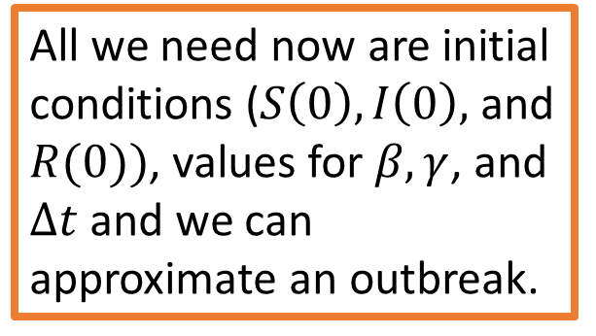
Compartmental models
$$β$$
$$γ$$
Susceptible
Infectious
Recovered
$$S\left(t+Δt\right)≈S\left(t\right)−βS\left(t\right)I\left(t\right)∗Δt$$
All we need now are initial conditions ($S\left(0\right), I\left(0\right),$ and $R(0))$, values for $β, γ$, and $Δt$ and we can approximate an outbreak.
$$I\left(t+Δt\right)≈I\left(t\right)+\left(βS\left(t\right)I\left(t\right)−γI\left(t\right)\right)∗Δt$$
$$R\left(t+Δt\right)≈R\left(t\right)+γI\left(t\right)∗Δt$$

Slide 27
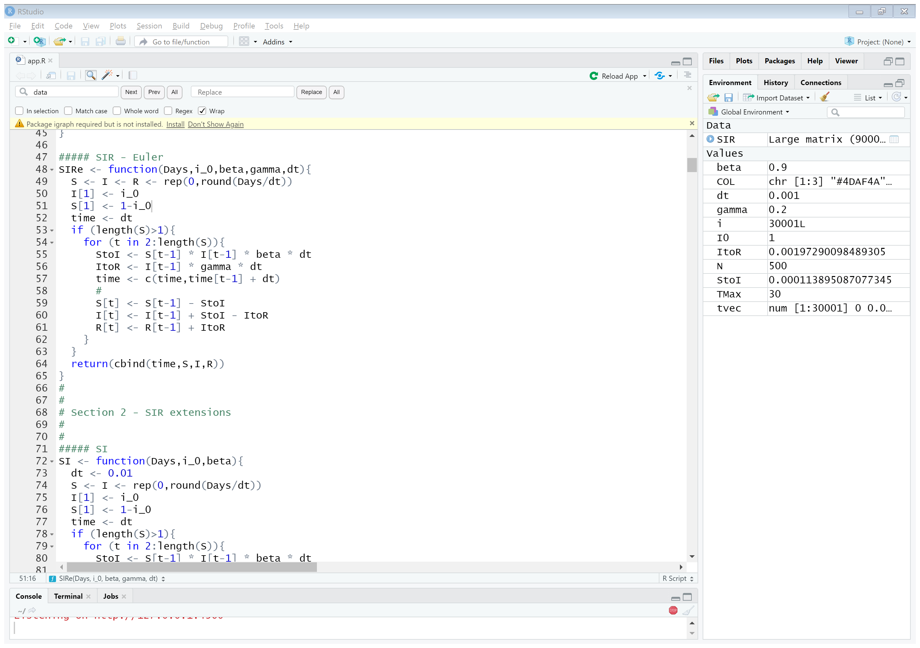
Compartmental models
$S\left(t+Δt\right)≈S\left(t\right)−βS\left(t\right)I\left(t\right)∗Δt$
$I\left(t+Δt\right)≈I\left(t\right)+βS\left(t\right)I(t)∗Δt−γI(t)∗Δt$
$R\left(t+Δt\right)≈R\left(t\right)+γI\left(t\right)∗Δt$

Slide 28
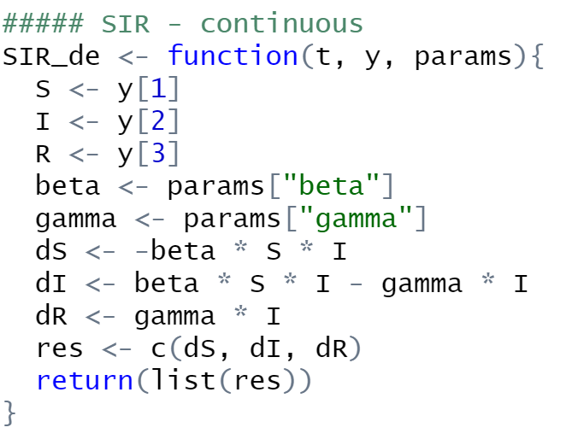
Compartmental models
vs
SIR models in Shiny

Slide 29
Compartmental models
SIR questions:
Can you create an outbreak that infects less than half the population?
Can you create an outbreak that has more than 90% of the population infectious at any one point in time?
What is the impact of the Euler approximation? Does it matter, and if so, when?
SIR models in Shiny

Slide 30
Extensions of the SIR model

Slide 31
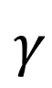
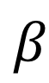

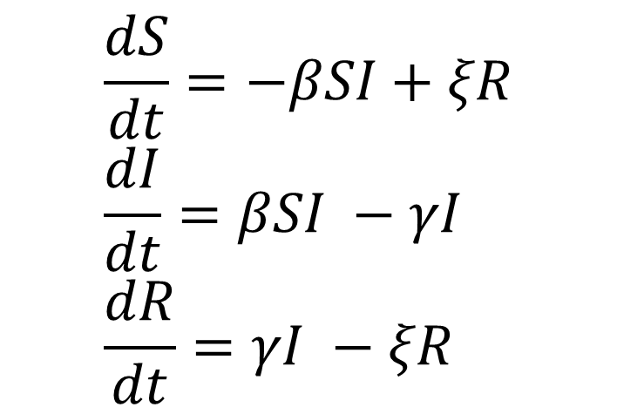
Extensions of the SIR model: SIRS
$$ξ$$
$$β$$
$$γ$$
Susceptible
Infectious
Recovered
$$\frac{dS}{dt}=−βSI+ξR \\ \frac{dI}{dt}=βSI −γI \\ \frac{dR}{dt}=γI −ξR$$
Temporary / waning immunity

Slide 32
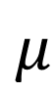
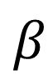
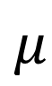
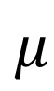
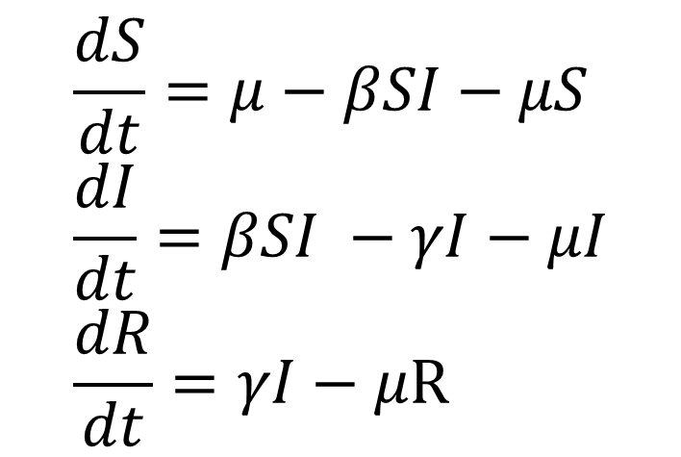
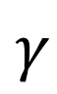
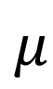
Extensions of the SIR model
$$μ$$
$$β$$
$$γ$$
Susceptible
Infectious
Recovered
$$μ$$
$$μ$$
$$μ$$
$$\frac{dS}{dt}=μ−βSI−μS \\ \frac{dI}{dt}=βSI −γI−μI \\ \frac{dR}{dt}=γI−μR$$
Demography

Slide 33
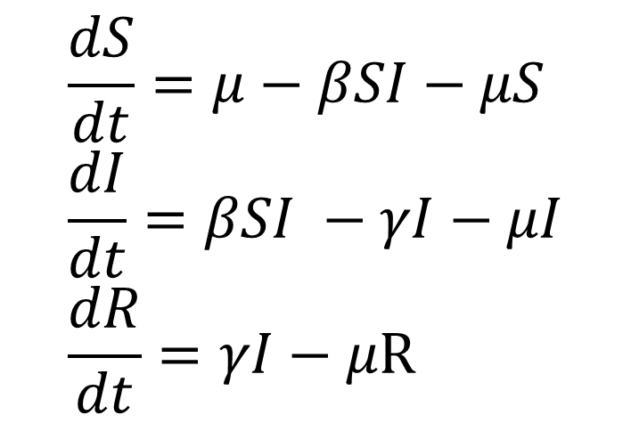
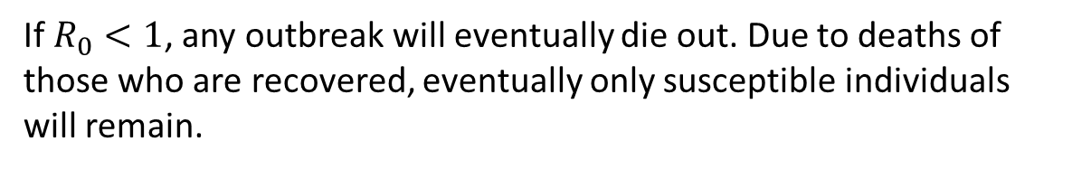
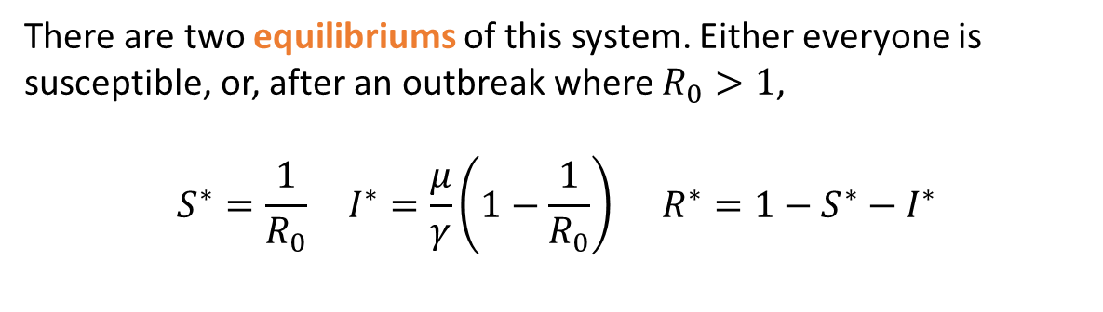

Extensions of the SIR model: Demography
$$\frac{dS}{dt}=μ−βSI−μS \\ \frac{dI}{dt}=βSI −γI−μI \\ \frac{dR}{dt}=γI−μR$$
For this model, we have
$$R_{0}=\frac{β}{γ+μ}$$
There are two equilibriums of this system. Either everyone is susceptible, or, after an outbreak where $R_{0}>1$,
$$S^{∗}=\frac{1}{R_{0}} I^{∗}=\frac{μ}{γ}\left(1−\frac{1}{R_{0}}\right) R^{∗}=1−S^{∗}−I^{∗}$$
If $R_{0}<1$, any outbreak will eventually die out. Due to deaths of those who are recovered, eventually only susceptible individuals will remain.

Slide 34
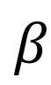
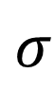


Extensions of the SIR model: SEIR
$$σ$$
$$β$$
$$γ$$
Susceptible
Exposed
Infectious
Recovered
$$\frac{dS}{dt}=−βSI \\ \frac{dE}{dt}=βSI −σE \\ \frac{dI}{dt}=σE −γI \\ \frac{dR}{dt}=γI$$
Pathogen incubation

Slide 35

Extensions of the SIR model
Extension models in Shiny

Slide 36
Extensions of the SIR model
Extensions of SIR questions:
For an SI model, can you create an outbreak that does not result in everyone infected?
For an SIS model, can you create an outbreak that results in a long run equal fraction of susceptibles and infecteds?
For an SEIR (or SEIRS) model, can you create an outbreak that has more than half the population ‘exposed’ at any point in time?
Extension models in Shiny

Slide 37
Drawbacks of differential equation models
(Some) limitations of these models:
(not in order of importance!)
Allow for “fractional” people
Deterministic
Constant rates
Well-mixed populations
Homogeneous populations
Difficult to include realistic interventions

Slide 38



Drawbacks of differential equation models
Problem: Differential equations allow “fractional” people
Solution: Reformulate in terms of population size & use rounding
$$\frac{dS}{dt}=−βSI \\ \frac{dI}{dt}=βSI −γI \\ \frac{dR}{dt}=γI$$
$$\frac{dX}{dt}=−\frac{βXY}{N} \\ \frac{dY}{dt}=\frac{βXY}{N} −γY \\ \frac{dZ}{dt}=γY$$
With a population of $N$ individuals, first re-write the SIR model, using $X$ to represent the number of susceptible individuals
$$X=S∗N$$
and $Y$ and $Z$ similarly for the number of infected and recovered individuals, respectively.

Slide 39

Drawbacks of differential equation models
Problem: Differential equations allow “fractional’”people
Solution: Reformulate in terms of population size & use rounding
$$\frac{dX}{dt}=−\frac{βXY}{N} \\ \frac{dY}{dt}=\frac{βXY}{N} −γY \\ \frac{dZ}{dt}=γY$$

Slide 40



Drawbacks of differential equation models
Problem: Differential equations allow “fractional” people
Solution: Reformulate in terms of population size & use rounding
$$X\left(t+Δt\right)−X\left(t\right)=\left[−\frac{βX\left(t\right)Y\left(t\right)}{N}∗Δt\right]$$
$$\frac{dX}{dt}=−\frac{βXY}{N} \\ \frac{dY}{dt}=\frac{βXY}{N} −γY \\ \frac{dZ}{dt}=γY$$
$$Y\left(t+Δt\right) −Y\left(t\right)=\left[\left(\frac{βX\left(t\right)Y\left(t\right)}{N}−γY\left(t\right)\right)∗Δt\right]$$
$$Z\left(t+Δt\right)=N−X\left(t+Δt\right)−Y(t+Δt)$$

Slide 41

Drawbacks of differential equation models
Problem: Model is deterministic
Solution: Reformulate in terms of probabilities
$$X\left(t+Δt\right)−X\left(t\right)=−\frac{βX\left(t\right)Y\left(t\right)}{N}∗Δt$$

Slide 42
Drawbacks of differential equation models
Problem: Model is deterministic
Solution: Reformulate in terms of probabilities
Number of new infections $=X\left(t\right)∗\left(\frac{βY\left(t\right)}{N}∗Δt\right)$

Slide 43

Drawbacks of differential equation models
Problem: Model is deterministic
Solution: Reformulate in terms of probabilities
Number of new infections $=X\left(t\right)∗\left(\frac{βY\left(t\right)}{N}∗Δt\right)$
We can re-imagine the number of susceptible people who become infected as a realization from a Binomial draw where the probability of “infection” is
$$\frac{βY\left(t\right)}{N}∗Δt$$

Slide 44
Drawbacks of differential equation models
Problem: Model is deterministic
Solution: Reformulate in terms of probabilities
Number of new infections $=X\left(t\right)∗\left(\frac{βY\left(t\right)}{N}∗Δt\right)$
We can re-imagine the number of susceptible people who become infected as a realization from a Binomial draw where the probability of “infection” is
$$\frac{βY\left(t\right)}{N}∗Δt$$
Number of new infections $∼Binomial\left(n=X\left(t\right), p=\frac{βY\left(t\right)}{N}∗Δt\right)$

Slide 45



Drawbacks of differential equation models
Problem: Model is deterministic
Solution: Reformulate in terms of probabilities
$$X\left(t+Δt\right)=X\left(t\right)−ΔN_{i} \\ Y\left(t+Δt\right)=Y\left(t\right)+ΔN_{i}−ΔN_{r} \\ Z\left(t+Δt\right)=Z\left(t\right)+ΔN_{r}$$
where
$$ΔN_{i}∼Binomial\left(n=X\left(t\right), p=\frac{βY\left(t\right)}{N}∗Δt\right)$$
$$ΔN_{r}∼Binomial\left(n=Y\left(t\right), p=γ∗Δt\right)$$

Slide 46

Drawbacks of differential equation models
Stochastic models in Shiny

Slide 47
Extensions of the SIR model
Extensions of SIR questions (stochastic):
Create an outbreak that has a narrow range of uncertainty.
For an SIS model, can you create an outbreak where the average of the simulations has the fractions of susceptibles and infecteds equal in the long run?
Can you create a scenario where some realizations have the number of susceptibles increase in the beginning of the outbreak, but eventually all realizations have at most 80% of the population susceptible?
Note: These simulations may take a while. Try reducing the number of models run at once, simulation duration, and population size.
Stochastic models in Shiny

Slide 48

Extensions of the SIR model
Question 3:

Slide 49


Drawbacks of differential equation models
Problem: Rates are constant in time
Solution: Allow rates to change in time
$$X\left(t+Δt\right)−X\left(t\right)=−\frac{βX\left(t\right)Y\left(t\right)}{N}∗Δt$$
$$X\left(t+Δt\right)−X\left(t\right)=−\frac{β(t)X\left(t\right)Y\left(t\right)}{N}∗Δt$$
How should $β\left(t\right)$ vary in time?

Slide 50


Drawbacks of differential equation models
Problem: Rates are constant in time
Solution: Allow rates to change in time
$$X\left(t+Δt\right)−X\left(t\right)=−\frac{β(t)X\left(t\right)Y\left(t\right)}{N}∗Δt$$
$$β\left(t\right)=β∗\sin\left(\frac{2πt}{365}+h\right)$$
$$β\left(t\right)=β∗f(weather)$$
Etc…

Slide 51
Drawbacks of differential equation models
Problem: Populations are homogenous
Solution: Introduce even more equations…

Slide 52
Drawbacks of differential equation models
Children
Susceptible
Infectious
Recovered
Adults
Susceptible
Infectious
Recovered

Slide 53


Drawbacks of differential equation models
Children
Susceptible
Infectious
Recovered
Adults
Susceptible
Infectious
Recovered
$$\frac{dS_{c}}{dt}=−S_{c}\left(β_{cc}I_{c}+β_{ac}I_{a}\right)−δS_{c} \\ \frac{dI_{c}}{dt}=S_{c}\left(β_{cc}I_{c}+β_{ac}I_{a}\right)−γ_{c}I_{c}−δI_{c} \\ \frac{dR_{c}}{dt}=γ_{c}I_{c}−δR_{c}$$
$$\frac{dS_{a}}{dt}=−S_{a}\left(β_{ca}I_{c}+β_{aa}I_{a}\right)+δS_{c} \\ \frac{dI_{a}}{dt}=S_{a}\left(β_{ca}I_{c}+β_{aa}I_{a}\right)−γ_{a}I_{a}+δI_{c} \\ \frac{dR_{a}}{dt}=γ_{a}I_{a}+δR_{c}$$

Slide 54




Drawbacks of differential equation models
Age 1
Susceptible
Infectious
Recovered
$$⋮$$
$$⋮$$
$$⋮$$
$$⋮$$
Age n
Susceptible
Infectious
Recovered

Slide 55

Drawbacks of differential equation models
Age 1
Susceptible
Infectious
Recovered
$$⋮$$
$$⋮$$
$$⋮$$
$$⋮$$
Age n
Susceptible
Infectious
Recovered
$$\frac{dS_{i}}{dt}=δS_{i−1}−δS_{i}−S_{i}∗\sum_{j=1}^{n}{β_{j,i}}I_{j} \\ \frac{dI_{i}}{dt}=δI_{i−1}−δI_{i}+S_{i}∗\sum_{j=1}^{n}{β_{j,i}}I_{j}−γ_{i}I_{i} \\ \frac{dR_{i}}{dt}=δR_{i−1}−δR_{i}+γ_{i}I_{i}$$

Slide 56
Drawbacks of differential equation models
Problem: Populations are well-mixed
Solution: Introduce more equations…
Solution 2: Account for individuals

Slide 57


Drawbacks of differential equation models
Problem: Populations are well-mixed
Solution: Introduce more equations…
Solution 2: Account for sub-populations
As an example, imagine a population of 25 sub-populations (e.g., neighborhood, or individual).
Assume further, that we know something about contact patterns. For sub-population $i$, let $C_{i}$ be the set of all other sub-populations they interact with.

Slide 58




Drawbacks of differential equation models
Problem: Populations are well-mixed
Solution: Introduce more equations…
Solution 2: Account for sub-populations
Now, for individuals in a sub-population, their probability of being infected is a function of the number of people they interact with.
$$1−P(Infec)$$
Individual $i$
Susceptible
$$P(Infec)$$
$$P\left(Infec\right)=β\frac{\# Infec in C_{i}}{\# in C_{i}}$$
Infected

Slide 59
Drawbacks of differential equation models
Problem: Difficult to include realistic interventions
Solution: Give up and use ABMs!

Slide 60
Part 2: Agent-based models
We actually have already started working with ABMs. Once we started tracking each person through the “S”, “I”, and “R” stages, we were essentially using an ABM.
When we introduced stochasticity using binomial distributions, we were using an ABM (a binomial random draw is the same as a bunch of Bernoulli draws).
By embracing ABMs, we can easily incorporate considerable complexity!

Slide 61








Agent-based models
The hallmark of an ABM is the rules we assign to each individual (or agent). We can give each individual a set of contacts, a rate of infection, an infection history, an age, sex, etc…
A person’s probability of becoming exposed, infectious, infecting others, recovering, receiving an intervention, having that intervention work, etc., can all be configured…
All of this flexibility does however come at a cost.
$$β$$
$$γ$$
Susceptible
Infectious
Recovered

Slide 62







Considerations of ABMs
Levels of complexity
Notes:
There are a lot of things to consider when setting up an ABM. While they can be relatively simple or straight forward, complexity can accrue rapidly.
You have to make decisions on:
Individual-level attributes
Temporal scale: length of time steps?
Spatial scale: spatial scales
Types of agents (humans…mosquitoes…parasites too?) or even entire cities? Countries?
Which complexities are important for transmission dynamics??
Occam's razor: simplest explanation typically most plausible; can be true for models as well. If a simple model with few assumptions does a decent job of prediction, why make it more complicated? No need to keep adding parameters and overfitting the data. (Adding complexity increases probability of doing something that's just going to be wrong)

Slide 63


Considerations of ABMs
Levels of complexity
Input
…output…
Notes:
Disseminating results can be difficult, as it may take a lot of effort to understand what went into the model or how it’s different from someone elses…
Can function like a black box: user may not have any idea what’s going on underneath the hood…so pretty much any one can use it even though they may not understand it

Slide 64


Considerations of ABMs
Parameterization
Notes:
Linked to level of complexity, but can be difficult to parameterize model components
You may have a lot of parameters, it may be difficult to find real-world data, or it may be difficult to actually fit the parameters with data.
Models are sensitive to initial conditions, and they can be difficult to determine
[Note: almost nobody tries to fit an entire ABM to data; typically fit components to data…]

Slide 65


Considerations of ABMs
Computational burden
Notes:
(see above): Fitting data is hard!
Due to stochasticity and all the non-linear interactions that you’re inducing, different realizations of an ABM with same param’s & initial conditions yield different results; so you have to run models multiple times to get the mean trajectory & variation over time. Need to run lots of simulations!!

Slide 66

Considerations of ABMs
Emergent properties
Notes:
[can be part of mechanistic models, but are associated with ABMs]: whole is not a sum of the part
1. Pro: with simple rules, can generate realistic complex dynamics
2. Con: sometimes those complex dynamics are very different than what was expected!

Slide 67


Applications of ABMs
Notes:
In what cases would you want to use an ABM?
For anything that needs heterogeneity!
- Things that are local & focal: eg vector borne diseases
- Things that depend on contact structures: eg STI’s
- Things that require individual-level inteventions
a) precision medicine, eg everything…? (customizing care based on someone’s personal history)
b) contact tracing (HIV, SARS, Ebola, other STDs)
c) active case detection (malaria elimination)
[Ex: measles is very transmittable; it can act in a mass-action manner, so ODE models work really well. But with vaccination, those that are going to refuse vaccinations are more likely to be in contact with one another/belong to the same contact network…so within that community a mechanistic model might still work well, but at the boundaries where they’re interacting with those choosing to vaccinate, an ABM might work a lot better! The transmission dynamics are going to get more complicated with these new contact networks]

Slide 68
About EMOD
Notes:
Transition slide between speakers
Want to summarize the “considerations” section by making it clear
That ABMs are very cool but are hard to create yourself; that’s why it’s great to use EMOD
Since all of the issues are already solved (other than computational
Burden ;-)

Slide 69

About EMOD
Free, open-source software (freely use without listing IDM as a co-author)
Available on GitHub https://github.com/InstituteforDiseaseModeling/EMOD
Stochastic, agent-based model
Rigorously tested for quality and scientific accuracy
Notes:
What is EMOD:

Slide 70


About EMOD
Examine the effects of interventions to create actionable plans:
Conditions necessary for eradication
Predicted outcomes of particular strategies
Include complex cascade of care systems
Flexible framework:
Test theoretical conditions, create simulated data
Simulate realistic strategies in actual locations
Notes:
What is EMOD:

Slide 71

About EMOD
Notes:
We will get hands-on with EMOD and our QuickStart, but prior to the fun stuff we’re going to go through the background for what EMOD is, what it does, and how to use it. This is a schematic of our generic version.
BIG POINTS:
Contagion pool is the main difference between the various transmission modes
Nodes are geographic regions that can be small or large
Individual properties tag people with characteristics to increase heterogeneity in the model
Transmission rates
Intervention actions
Cascade of care

Slide 72
EMOD simulation types
Generic SEIRS
Environmental
Airborne
Vector
STI
Typhoid
Tuberculosis
+ Coinfection
Malaria
HIV
Polio
Dengue
Notes:
Structurally, EMOD is built upon a framework that acts as a generic SEIRS model. Maybe here just show the various model types we have? Basically want to show that a lot of things can be modeled, that emod has a lot of variety.
-There is a Hierarchical inheritance of code & features built off the generic with different transmission modes branching off
- because core code can be reused, it ensures a lot of testing & confidence in model structure, and new models don’t have to be built from scratch, (saves time!)
- easy to add, customize, or modify features, or even build new models for different diseases
Dashed line indicates models that have not been publicly released; bolded titles are those with specific doc sets
The more the model gets used, the better it becomes!
**Dengue model: good example of how you can easily/quickly create a new disease model off existing code; also, zika can be modeled

Slide 73



Interacting with EMOD
Running EMOD involves looking at files in JSON format…

Slide 74
Interacting with EMOD
Running EMOD involves looking at files in JSON format…
but we have a more fun way to learn the model!

Slide 75


EMOD QuickStart overview quickstart.idmod.org
Graphs update dynamically
Modular lessons to explore particular aspects of the model
JSON input files update dynamically
Explore the function of related sets of parameters
Notes:
Web-based learning tool—works on any OS with no downloads
Modular lessons break the EMOD model into components
Configure the model via UI to learn the input format required by the model for regular simulations
Immediate feedback via quick simulations and automatic plotting of output
Gain intuition about the model before moving onto more involved scenarios

Slide 76
QuickStart exercise
Go to https://quickstart.idmod.org/
Click From SIR models to ABMs
On the left-side TOC, click Configure parameters
This section relates the terms used in differential equations with the parameters used in EMOD
Prior sections review the SIR differential equations that we presented earlier today
Notes:
Home page:
Filter on different lesson categories
Follow a linear lesson plan or just explore on your own
We encourage you to explore more on your own after the workshop
Lessons:
Left: TOC
Middle: Curriculum and UI elements to set parameter values
Upper right: immediate graph of output
Lower right: JSON input files

Slide 77


QuickStart exercise: From SIR models to ABMs
$$β$$
Base_Infectivity is equivalent to
Infectious_Period_Constant is equivalent to 1/ (if the infectious period is constant for all agents and not assigned using a distribution)
Exercises:
Starting from an SEIR model, can you make the peak of infection happen at day 50?
Can you end with 50% of population never infected?
Can you achieve the same things with R₀ fixed at 2? At 16?
$$γ$$
Notes:
(Discuss how you accomplished the tasks)

Slide 78
Run EMOD locally
Boot into the provided USB drive (see handout for instructions based on your OS)
To log in to the USB, the username is “research” and the password is “idm”
Navigate to EMODScenarios>Scenarios>Generic>SEIR
Double-click RunEmod to run an EMOD simulation using the provided input files
Once the simulation has finished running, double-click the plotAllCharts and plotInsetChart scripts to create plots of the output using Python
Double-click on config.json (this should look more familiar now).
Alter ‘Base_Infectivity’ based on your previous experimentation (don’t forget to save). Re-run the model simulation
Note: this will work for every scenario in the USB drive. See http://idmod.org/docs/ for documentation

Slide 79
EMOD simulation scenarios: SEIR model
Objective: Using an R script to alter EMOD and visualize output, familiarize yourself with the options for a basic SEIR model.
Using the R script ‘SEIR.r’, you can alter the duration of infectiousness.
First, change Base_Incubation_Period to Incubation_Period_Constant, and Base_Infectious_Period to Infectious_Period_Constant.
Exercises:
Using your favorite value for Base_Infectivity, assess the impact of stochasticity.

Slide 80
Using EMOD for your own research
Install EMOD on your own machine:
Instructions and required software install found here: http://idmod.org/docs/general/install-overview.html
Docker image also available: https://packages.idmod.org/artifactory/webapp/#/artifacts/browse/tree/General/idm-docker-public
Local install supported on Windows and Linux
Run locally or connect to your institutions’ HPC
Use IDM-Tools (suite of Python packages) designed for facilitating job creation, management, and data analysis
All scenario files (and today’s PPT decks) available here: https://github.com/InstituteforDiseaseModeling/docs-emod-scenarios
Notes:
PROVIDE EXAMPLES FOR PROJECTS THEY COULD USE EMOD FOR!!
(not sure if the “discussion” should go before or after the emod architecture info coming next.)

Slide 81
Further information
Notes:
Transition slide between speakers

Slide 82
Further information
Want to learn more about using EMOD?
Join the afternoon workshop to run more EMOD simulations and learn more advanced features of the model
Continue working through QuickStart lessons
Use the documentation at http://idmod.org/documentation
Email us! If you are working with a particular researcher, feel free to reach out to them. Otherwise, please email IDM support at support@idmod.org
Bobby Reiner: bcreiner@uw.edu
Mandy Izzo: mizzo@idmod.org
Jen Schripsema: jschripsema@idmod.org
Follow us on Twitter! @IDMOD_ORG
Notes:
Also encourage them to reach out to us for training sessions! (Mandy & Jen)
SUMMARIZE:
-We are so glad to have had the opportunity to work with all of you today. We hope that we were able to demonstrate the utility of models for disease research, as well as to provide a foundation for you to learn more.
Specifically, we hope you gained a basic understanding of both compartmental and agent-based disease models
Further, we introduced some of our tools, namely our QuickStart application and EMOD. With these, you should have gained familiarity with the JSON-formatted input and output files for running simulations with EMOD

Slide 83
Research at IDM: Opportunities for collaboration!
Current research areas:
Household-level modeling for malaria
Typhoid
Measles
Polio
Network models
TB
HIV
Vaccine distribution economics
Family planning
Applied math
Opportunities to engage:
Work at IDM:
Post-doctoral positions
Open research positions
Summer internships
Collaborate!
Visiting scholar positions at IDM
Joint research projects
IDM annual Symposium (April! Bellevue, WA)
IDM training sessions
On-site at your university
On-site at IDM

Slide 84
Don’t forget: please join us this evening for an IDM-hosted dinner at Rosa Mexicano, following the conclusion of the advanced session at 6:00 pm!
Notes:
REMIND THEM ABOUT DINNER AGAIN
If extra time, we can go over questions they may have about their own research
We would love to see you back for the afternoon session as well! Let them know they want to come in 20-30 minutes late as we will be briefly reviewing compartmental models.

Slide 85
Solutions to exercises
Note that there are multiple ways of solving these questions. The solutions presented are just one method.

Slide 86

Compartmental models
SIR solutions:
Can you create an outbreak that infects less than half the population?
Any model for which gamma $≈$ beta or larger
Can you create an outbreak that has more than 90% of the population infectious at any one point in time?
Set gamma to a very small number (e.g., 0.01)
What is the impact of the Euler approximation? Does it matter, and if so, when?
For large values, the approximation is extremely poor. Depending on the intensity of transmission, you may get values outside of the 0-100% range for susceptibles or infecteds. For small values, the approximation has negligible error. In all cases, the impact of the approximation is larger at the beginning of the outbreak.

Slide 87
Extensions of the SIR model
Extensions of SIR solutions:
For an SI model, can you create an outbreak that does not result in everyone infected?
No. Unless you cheat and have the outbreak be no outbreak at all. Side note: technically no deterministic SI outbreak results in “everyone” getting infected in a finite amount of time. There is always some increasingly smaller fraction of a person who is still susceptible.
For an SIS model, can you create an outbreak that results in a long run equal fraction of susceptibles and infecteds?
Set delta = ½ beta
For an SEIR (or SEIRS) model, can you create an outbreak that has more than half the population ‘exposed’ at any point in time?
Answers may vary; try for a large beta and a small gamma and sigma (e.g., beta = 1, gamma = 0.1, sigma = 0.1).

Slide 88
Extensions of the SIR model
Extensions of SIR solutions (stochastic):
Create an outbreak that has a narrow range of uncertainty.
The easiest way is to increase the population size and the % of the initial population infectious.
For an SIS model, can you create an outbreak where the average of the simulations has the fractions of susceptibles and infecteds equal in the long run?
Probably not! If you did, you got lucky ;-) To get close, as before, you want delta = ½ beta
Can you create a scenario where some realizations have the number of susceptibles increase in the beginning of the outbreak, but eventually all realizations have at most 80% of the population susceptible?
Answers will vary, and the same parameter values may not yield a successful solution from simulation to simulation. You will need a model with waning immunity and slow initial transmission intensity. Because we eventually want the outbreak to hit most people, beta must be “large-ish” so you can achieve this by having I(0) be small.

Slide 89
QuickStart exercise: From SIR models to ABMs
Solutions:
Starting from an SEIR model, can you make the peak of infection happen at day 50?
Simple way is to increase the incubation period (e.g.,on exponential, set to 25. You may also need to change R0 by decreasing Base_infectivity and increasing Infectious_Period_(Exponential)).
Can you end with 50% of population never infected?
You want a small R0: set Base_Infectivity to a small value (e.g., 0.4) and modify the value for Infectious_Period_Exponential (e.g., 3.5).
Can you achieve the same things with R₀ fixed at 2? At 16?
It’s harder! Manipulate Incubation_Period_Exponential. Ex: Base_Infectivity =1, Infectious_Period_Distribution = 2, set Incubation_Period_Exponential = 4 (peak on day 50). R0 = 16 (values are 2, 8 respectively): set Incubation period to 16 for peak on day 50. How about the 50% not infected? (Nope).
Notes:
(Discuss how you accomplished the tasks)

